Slide 1
The Bear Flag Candlestick Pattern
The bearish flag is a candlestick chart pattern that signals the extension of the downtrend once the temporary pause is finished. As a continuation pattern, the bear flag helps sellers to push the price action further lower. After a strong downtrend, the price action consolidates within the two parallel trend lines in the opposite direction of the downtrend. Once the supporting trend line gets broken, the bear flag pattern is activated as the price action continues trading lower.

Slide 2
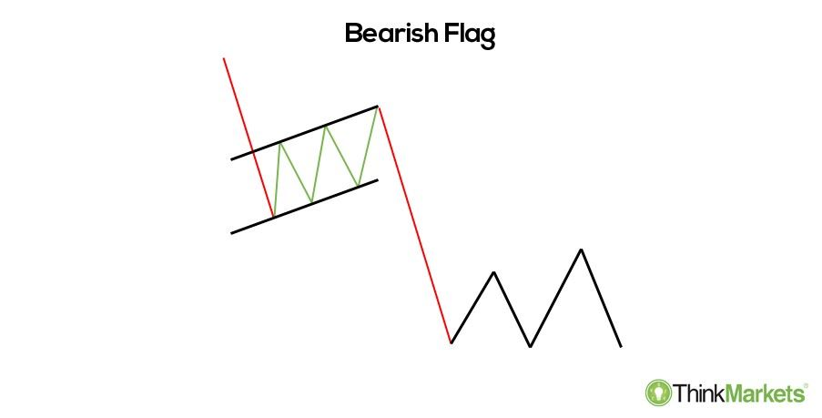
Once the new low is in place, the price action starts to rebound higher as the sellers take a breather. This consolidation takes place within a parallel channel, unlike in the bearish pennant where the consolidation is formatted in a wedge or a triangle. The buyers use the consolidation to try and weaken the momentum of the sellers, who are in control of the price action. On the other hand, the bears take a step back to consolidate the most recent gains and prepare for another push lower.

Slide 3
This consolidation phase shouldn’t extend too high. Depending on the strength of a downtrend, the rebound may be sharper or milder. In general, the rebound shouldn’t extend above the 50% Fibonacci retracement of the flagpole.
These three elements are integral for the bearish flag to occur:
The flagpole - the asset’s price must trade lower in a series of the higher highs and higher lows;
Flag - a consolidation must take place between two parallel trend lines in an uptrend;
A breakout - a break of the supporting trend line signals the activation of the pattern.

Slide 4
More precisely, the flag will tell us whether the consolidation phase is over as the sellers increase their pressure. The breakout provides us with precisely defined levels to play with, as you will see in the example below.
In general, the bear flag is considered to be a strong technical pattern. This is especially the case when the retracement ends at around 38.2%, creating a textbook bear flag pattern. Therefore, its greatest advantage is that it offers a very attractiverisk-reward ratio, as levels are clearly defined.
Therefore, it's advised not to trade flags that have long and choppy consolidation phases, as well as those that extend higher than 50%.

Slide 5
Spotting the Bear Flag Chart Pattern
As mentioned earlier, the bear flag is a bearish continuation pattern. The first step in identifying the bear flag is to look for a downtrend. Next, the rebound should take place within an ascending channel, while we monitor the degree of the correction.
EUR/USD has been moving lower in an aggressive downtrend before a mild rebound started, which was short-lived given the overall strength of the initial move lower. Still, the price action consolidated within the two parallel lines before the bears had retaken control.

Slide 6
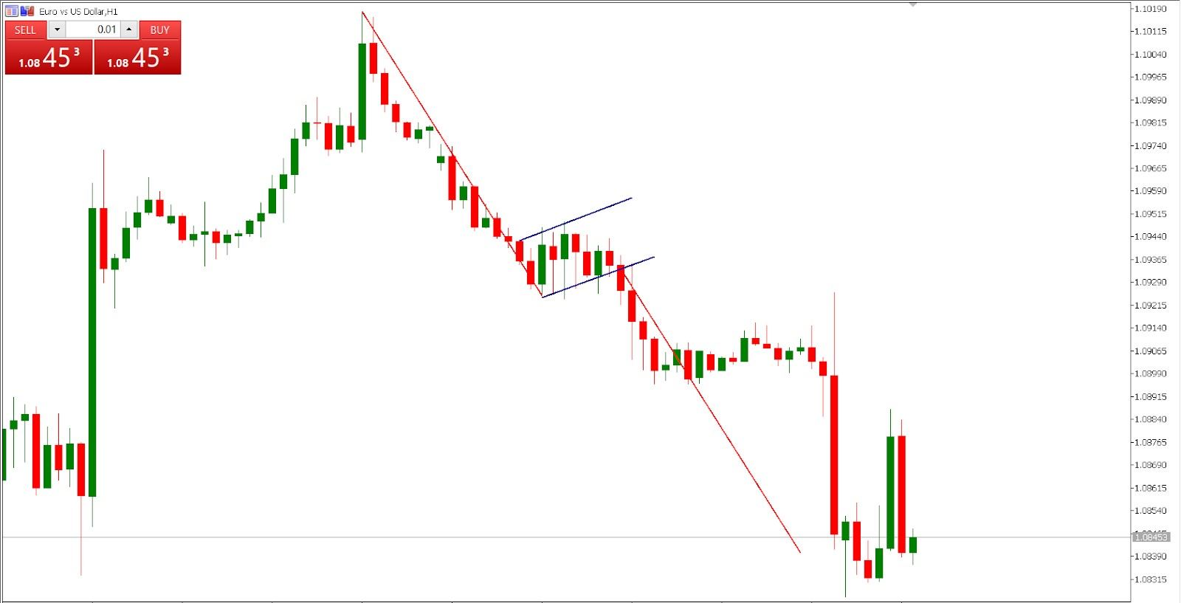
In this case, the rebound didn’t even manage to extend to the first Fibonacci retracement level of 23.6% before the sellers were successful in pushing the action lower. Hence, the overall downtrend usually dictates the power and pace of a rebound.

Slide 7

In our example, we are presented with both standard entry options after the breakout occurs. The first option results in the opening of a trade as soon as the breakout candle closes below the flag.

Slide 8
Just to make sure that we are in a trade, we choose option no.1. Hence, a sell trade is entered after the breakout candle closed comfortably below the lower trend line. The stop loss is around 20 pips higher from the entry and within the channel territory. As with the bull flag, a clean move to the inside of the flag invalidates the bear flag pattern. The take profit level is calculated by measuring the distance of the flagpole. The trend line is then copy-pasted, starting from the point where the breakout occurred, with the ending point signalling a level where we should consider booking our profits, if the opportunity arises.

Slide 9
